Slide 1
Relation

Slide 2

Introduction
Let A and B be sets. A binary relation from A to B is a subset of A × B.

Slide 3
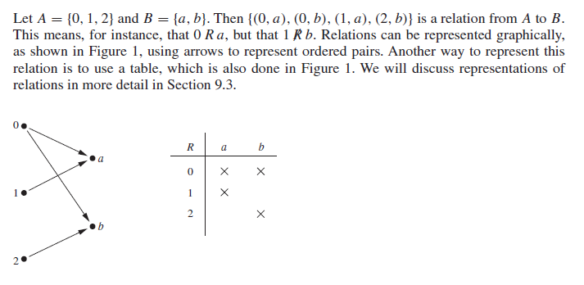
Example

Slide 4
Example
Let A be the set of students in your school, and let B be the set of courses. Let R be the relation that consists of those pairs (a, b), where a is a student enrolled in course b.
For instance, if Jason Goodfriend and Deborah Sherman are enrolled in CS518, the pairs (Jason Goodfriend, CS518) and (Deborah Sherman, CS518) belong to R. If Jason Goodfriend is also enrolled in CS510, then the pair (Jason Goodfriend, CS510) is also in R.
However, if Deborah Sherman is not enrolled in CS510, then the pair (Deborah Sherman, CS510) is not in R.

Slide 5
Example
Let A be the set of cities in the U.S.A., and let B be the set of the 50 states in the U.S.A. Define the relation R by specifying that (a, b) belongs to R if a city with name a is in the state b. For instance, (Boulder, Colorado), (Bangor, Maine), (Ann Arbor, Michigan), (Middletown, New Jersey), (Middletown, New York), (Cupertino, California), and (Red Bank, New Jersey) are in R.
Relations on a Set
A relation on a set A is a relation from A to A.
In other words, a relation on a set A is a subset of A × A.

Slide 6
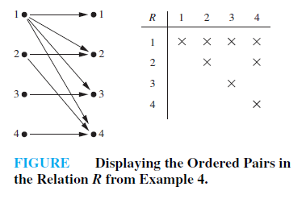
Example
Let A be the set {1, 2, 3, 4}. Which ordered pairs are in the relation R = {(a, b) | a divides b}?
Solution
Because (a, b) is in R if and only if a and b are positive integers not exceeding 4 such that a divides b, we see that
R = {(1, 1), (1, 2), (1, 3), (1, 4), (2, 2), (2, 4), (3, 3), (4, 4)}.

Slide 7
Example
Consider these relations on the set of integers:
R1 = {(a, b) | a ≤ b},
R2 = {(a, b) | a > b},
R3 = {(a, b) | a = b or a = −b},
R4 = {(a, b) | a = b},
R5 = {(a, b) | a = b + 1},
R6 = {(a, b) | a + b ≤ 3}.
Which of these relations contain each of the pairs (1, 1), (1, 2), (2, 1), (1,−1), and (2, 2)? These are relations on an infinite set.
Solution
The pair (1, 1) is in R₁, R₃, R₄, and R₆; (1, 2) is in R₁ and R₆; (2, 1) is in R₂, R₅, and R₆; (1,−1) is in R₂, R₃, and R₆; and finally, (2, 2) is in R₁, R₃, and R₄.

Slide 8
Properties of Relation-Reflexive
A relation R on a set A is called reflexive if (a, a) ∈ R for every element a∈ A.
Example
Consider the following relations on {1, 2, 3, 4}:
R₁ = {(1, 1), (1, 2), (2, 1), (2, 2), (3, 4), (4, 1), (4, 4)},
R₂ = {(1, 1), (1, 2), (2, 1)},
R₃ = {(1, 1), (1, 2), (1, 4), (2, 1), (2, 2), (3, 3), (4, 1), (4, 4)},
R₄ = {(2, 1), (3, 1), (3, 2), (4, 1), (4, 2), (4, 3)},
R₅ = {(1, 1), (1, 2), (1, 3), (1, 4), (2, 2), (2, 3), (2, 4), (3, 3), (3, 4), (4,4)},
R₆ = {(3, 4)}.
Which of these relations are reflexive?

Slide 9
Solution
R₁ = {(1, 1), (1, 2), (2, 1), (2, 2), (3, 4), (4, 1), (4, 4)},
R₂ = {(1, 1), (1, 2), (2, 1)},
R₃ = {(1, 1), (1, 2), (1, 4), (2, 1), (2, 2), (3, 3), (4, 1), (4, 4)},
R₄ = {(2, 1), (3, 1), (3, 2), (4, 1), (4, 2), (4, 3)},
R₅ = {(1, 1), (1, 2), (1, 3), (1, 4), (2, 2), (2, 3), (2, 4), (3, 3), (3, 4), (4,4)},
R₆ = {(3, 4)}.
The relations R₃ and R₅ are reflexive because they both contain all pairs of the form (a, a), namely, (1, 1), (2, 2), (3, 3), and (4, 4). The other relations are not reflexive because they do not contain all of these ordered pairs. In particular, R₁, R₂, R₄, and R₆ are not reflexive because (3, 3) is not in any of these relations.

Slide 10
Example
Which of the following relations are reflexive?
R₁ = {(a, b) | a ≤ b},
R₂ = {(a, b) | a > b},
R₃ = {(a, b) | a = b or a = −b},
R₄ = {(a, b) | a = b},
R₅ = {(a, b) | a = b + 1},
R₆ = {(a, b) | a + b ≤ 3}.
Solution
The reflexive relations are R₁ (because a ≤ a for every integer a), R₃, and R₄.

Slide 11
Example
Is the “divides” relation on the set of positive integers reflexive?
Solution
Because a | a whenever a is a positive integer, the “divides” relation is reflexive. (Note that if we replace the set of positive integers with the set of all integers the relation is not reflexive because by definition 0 does not divide 0.)

Slide 12
Properties of Relation-Symmetric and Antisymmetric
A relation R on a set A is called symmetric if (b, a) ∈ R whenever (a, b) ∈ R, for all a, b ∈ A.
A relation R on a set A such that for all a, b ∈ A, if (a, b) ∈ R and (b, a) ∈ R, then a = b ,is called antisymmetric.
Using quantifiers, we see that the relation R on the set A is symmetric if ∀a∀b((a, b) ∈ R → (b, a) ∈ R).
Similarly, the relation R on the set A is antisymmetric if ∀a∀b(((a, b) ∈ R ∧ (b, a) ∈ R) → (a = b)).

Slide 13
Example
Consider the following relations on {1, 2, 3, 4}:
R₁ = {(1, 1), (1, 2), (2, 1), (2, 2), (3, 4), (4, 1), (4, 4)},
R₂ = {(1, 1), (1, 2), (2, 1)},
R₃ = {(1, 1), (1, 2), (1, 4), (2, 1), (2, 2), (3, 3), (4, 1), (4, 4)},
R₄ = {(2, 1), (3, 1), (3, 2), (4, 1), (4, 2), (4, 3)},
R₅ = {(1, 1), (1, 2), (1, 3), (1, 4), (2, 2), (2, 3), (2, 4), (3, 3), (3, 4), (4, 4)},
R₆ = {(3, 4)}.
Which of these relations are symmetric and which are antisymmetric?
Solution
The relations R₂ and R₃ are symmetric, because in each case (b, a) belongs to the relation whenever (a, b) does.
For R₂, the only thing to check is that both (2, 1) and (1, 2) are in the relation.
For R₃, it is necessary to check that both (1, 2) and (2, 1) belong to the relation, and (1, 4) and (4, 1) belong to the relation.

Slide 14
Solution-Continue
R₁ = {(1, 1), (1, 2), (2, 1), (2, 2), (3, 4), (4, 1), (4, 4)},
R₂ = {(1, 1), (1, 2), (2, 1)},
R₃ = {(1, 1), (1, 2), (1, 4), (2, 1), (2, 2), (3, 3), (4, 1), (4, 4)},
R₄ = {(2, 1), (3, 1), (3, 2), (4, 1), (4, 2), (4, 3)},
R₅ = {(1, 1), (1, 2), (1, 3), (1, 4), (2, 2), (2, 3), (2, 4), (3, 3), (3, 4), (4, 4)},
R₆ = {(3, 4)}.
R₄, R₅, and R₆ are all antisymmetric. For each of these relations there is no pair of elements a and b with a ≠ b such that both (a, b) and (b, a) belong to the relation.
Example
Why is R₂ = {(1,2), (2,1), (3,1)} not symmetric?
Because (1,3) is missing.

Slide 15
Example
Which of the following relations are symmetric and which are antisymmetric?
R₁ = {(a, b) | a ≤ b}
R₂ = {(a, b) | a > b},
R₃ = {(a, b) | a = b or a = −b},
R₄ = {(a, b) | a = b},
R₅ = {(a, b) | a = b + 1},
R₆ = {(a, b) | a + b ≤ 3}.
Solution
The relations R₃, R₄, and R₆ are symmetric.
R₃ is symmetric, for if a = b or a = −b, then b = a or b = −a.
R₄ is symmetric because a = b implies that b = a.
R₆ is symmetric because a + b ≤ 3 implies that b + a ≤ 3.

Slide 16
Solution-Continue
R₁ = {(a, b) | a ≤ b}
R₂ = {(a, b) | a > b},
R₃ = {(a, b) | a = b or a = −b},
R₄ = {(a, b) | a = b},
R₅ = {(a, b) | a = b + 1},
R₆ = {(a, b) | a + b ≤ 3}.
The relations R₁, R₂, R₄, and R₅ are antisymmetric.
R₁ is antisymmetric because the inequalities a ≤ b and b ≤ a imply that a = b.
R₂ is antisymmetric because it is impossible that a > b and b > a.
R₄ is antisymmetric, because two elements are related with respect to R₄ if and only if they are equal.
R₅ is antisymmetric because it is impossible that a = b + 1 and b = a +1.

Slide 17
Example
Is the “divides” relation on the set of positive integers symmetric? Is it antisymmetric?

Slide 18
Thinks to know
The terms symmetric and antisymmetric are not opposites, because a relation can have both of these properties or may lack both of them
R = { (a,b) | a = b} is an example of a relation of a set that is both symmetric and antisymmetric. It is both symmetric because if (a,b) ∈ R, then (b,a) ∈ R (if a = b). Since (a,b) ∈ R and (b,a) ∈ R if and only if a = b, then it is anti-symmetric.
R = { (0,1),(0,2),(2,0)} is an example of a relation of a set that is neither symmetric and nor antisymmetric.
  R is not symmetric, because ⟨0,1⟩∈R but ⟨1,0⟩∉R and
  R is not antisymmetric, because ⟨0,2⟩,⟨2,0⟩∈R but 0≠2

Slide 19
Properties of Relation-Transitive
A relation R on a set A is called transitive if whenever (a, b) ∈ R and (b, c) ∈ R, then (a, c) ∈ R, for all a, b, c ∈ A.
Using quantifiers we see that the relation R on a set A is transitive if we have ∀a∀b∀c(((a, b) ∈ R ∧ (b, c) ∈ R) → (a, c) ∈ R).

Slide 20
Example
Consider the following relations on {1, 2, 3, 4}:
R₁ = {(1, 1), (1, 2), (2, 1), (2, 2), (3, 4), (4, 1), (4, 4)},
R₂ = {(1, 1), (1, 2), (2, 1)},
R₃ = {(1, 1), (1, 2), (1, 4), (2, 1), (2, 2), (3, 3), (4, 1), (4, 4)},
R₄ = {(2, 1), (3, 1), (3, 2), (4, 1), (4, 2), (4, 3)},
R₅ = {(1, 1), (1, 2), (1, 3), (1, 4), (2, 2), (2, 3), (2, 4), (3, 3), (3, 4), (4, 4)},
R₆ = {(3, 4)}.
Which of these relations are transitive?
R₄, R₅, and R₆ are transitive. For each of these relations, we can show that it is transitive by verifying that if (a, b) and (b, c) belong to this relation, then (a, c) also does. For instance, R₄ is transitive, because (3, 2) and (2, 1), (4, 2) and (2, 1), (4, 3) and (3, 1), and (4, 3) and (3, 2) are the only such sets of pairs, and (3, 1), (4, 1), and (4, 2) belong to R₄.
R5 , R6 → Do yourself.

Slide 21
Continue
R₁ = {(1, 1), (1, 2), (2, 1), (2, 2), (3, 4), (4, 1), (4, 4)},
R₂ = {(1, 1), (1, 2), (2, 1)},
R₃ = {(1, 1), (1, 2), (1, 4), (2, 1), (2, 2), (3, 3), (4, 1), (4, 4)},
R₄ = {(2, 1), (3, 1), (3, 2), (4, 1), (4, 2), (4, 3)},
R₅ = {(1, 1), (1, 2), (1, 3), (1, 4), (2, 2), (2, 3), (2, 4), (3, 3), (3, 4), (4, 4)},
R₆ = {(3, 4)}.
R₁ is not transitive because (3, 4) and (4, 1) belong to R1, but (3, 1) does not.
R₂ is not transitive because (2, 1) and (1, 2) belong to R2, but (2, 2) does not.
R₃ is not transitive because (4, 1) and (1, 2) belong to R3, but (4, 2) does not.

Slide 22
Example
Which of the following relation is transitive?
R₁ = {(a, b) | a ≤ b}
R₂ = {(a, b) | a > b},
R₃ = {(a, b) | a = b or a = −b},
R₄ = {(a, b) | a = b},
R₅ = {(a, b) | a = b + 1},
R₆ = {(a, b) | a + b ≤ 3}.
The relationsR₁,R₂,R₃, andR₄ are transitive.
R₁ is transitive because a ≤ b and b ≤ c imply that a ≤ c.
R₂ is transitive because a > b and b > c imply that a > c.
R₃ is transitive because a=±b and b=±c imply that a=±c.
R₄ is clearly transitive because a=b and b=c imply a=c.

Slide 23
Continue
R₁ = {(a, b) | a ≤ b}
R₂ = {(a, b) | a > b},
R₃ = {(a, b) | a = b or a = −b},
R₄ = {(a, b) | a = b},
R₅ = {(a, b) | a = b + 1},
R₆ = {(a, b) | a + b ≤ 3}.
R₅ is not transitive because (2, 1) and (1, 0) belong to R₅, but (2, 0) does not.
R₆ is not transitive because (2, 1) and (1, 2) belong to R₆, but (2, 2) does not.

Slide 24
Example
Is the “divides” relation on the set of positive integers transitive?
Solution
Suppose that a divides b and b divides c. Then there are positive integers k and l such that b = ak and c = bl. Hence, c = a(kl), so a divides c. It follows that this relation is transitive.

Slide 25
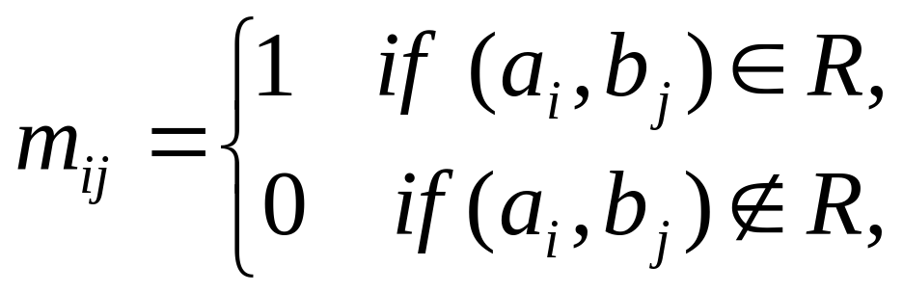
Representing Relations Using Matrices
A relation between finite sets can be represented using a zero–one matrix. Suppose that R is a relation from A = {a₁, a₂, . . . , a_{m}} to B = {b₁, b₂, . . . , b_{n}}. The relation R can be represented by the matrix M_{R} = [m_{ij} ],
where

Slide 26

Example
Suppose that A = {1, 2, 3} and B = {1, 2}. Let R be the relation from A to B containing (a, b) if a ∈ A, b ∈ B, and a > b. What is the matrix representing R if a₁ = 1, a₂ = 2, and a₃ = 3, and b₁ = 1 and b₂ = 2?
Solution
Because R = {(2, 1), (3, 1), (3, 2)}, the matrix for R is

Slide 27
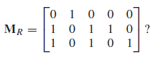

Example
Let A = {a₁, a₂, a₃} and B = {b₁, b₂, b₃, b₄, b₅}. Which ordered pairs are in the relation R represented by the matrix

Slide 28
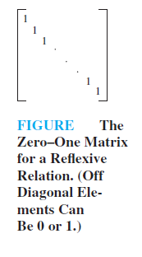
The Zero-One Matrix for a Reflexive Relation
The matrix of a relation on a set, which is a square matrix, can be used to determine whether the relation has certain properties.
Recall that a relation R on A is reflexive if (a, a) ∈ R whenever a ∈ A.
Thus, R is reflexive if and only if (a_{i}, a_{i}) ∈ R for i = 1, 2, . . . , n.
Hence, R is reflexive if and only if m_{ii} = 1, for i = 1, 2, . . . , n.
In other words, R is reflexive if all the elements on the main diagonal of M_{R} are equal to 1.
Note that the elements off the main diagonal can be either 0 or 1.

Slide 29
The Zero-One Matrices for Symmetric Relations
The relation R is symmetric if (a, b) ∈ R implies that (b, a) ∈ R.
Consequently, the relation R on the set A = {a₁, a₂, . . . , a_{n}} is symmetric if and only if (a_{j}, a_{i}) ∈ R whenever (a_{i}, a_{j} ) ∈ R.
In terms of the entries of M_{R}, R is symmetric if and only if m_{ji} = 1 whenever m_{ij} = 1.
This also means mji = 0 whenever mij = 0.
Consequently, R is symmetric if and only if m_{ij} = m_{ji} , for all pairs of integers i and j with i = 1, 2, . . . , n and j = 1, 2, . . . , n.

Slide 30
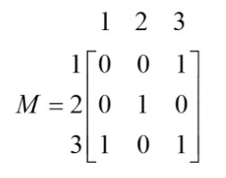
Matrix Representation of a Symmetric Relation

Slide 31
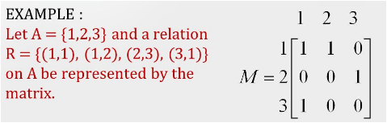
The Zero-One Matrices for antisymmetric Relations
The relation R is antisymmetric if and only if (a, b) ∈ R and (b, a) ∈ R imply that a = b.
Consequently, the matrix of an antisymmetric relation has the property that if m_{ij} = 1 with i ≠ j , then m_{ji} = 0. Or, in other words, either mij = 0 or mji = 0 when i ≠ j .

Slide 32

Example
Suppose that the relation R on a set is represented by the matrix
Is R reflexive, symmetric, and/or antisymmetric?
Solution
Because all the diagonal elements of this matrix are equal to 1,R is reflexive. Moreover, because M_{R} is symmetric, it follows that R is symmetric. It is also easy to see that R is not antisymmetric.

Slide 33
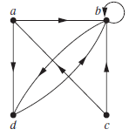
Representing Relations Using Digraphs
A directed graph, or digraph, consists of a set V of vertices (or nodes) together with a set E of ordered pairs of elements of V called edges (or arcs). The vertex a is called the initial vertex of the edge (a, b), and the vertex b is called the terminal vertex of this edge.
An edge of the form (a, a) is represented using an arc from the vertex a back to itself. Such an edge is called a loop.
The directed graph with vertices a, b, c, and d, and edges (a, b), (a, d), (b, b), (b, d), (c, a), (c, b), and (d, b) is displayed in Figure below.

Slide 34
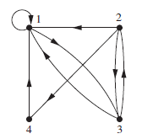
Continue
The relation R on a set A is represented by the directed graph that has the elements of A as its vertices and the ordered pairs (a, b), where (a, b) ∈ R, as edges.
Example
The directed graph of the relation
R = {(1, 1), (1, 3), (2, 1), (2, 3), (2, 4), (3, 1), (3, 2), (4, 1)}
on the set {1, 2, 3, 4} is shown in Figure below.

Slide 35
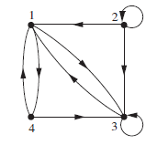
Example
What are the ordered pairs in the relation R represented by the directed graph shown in Figure below?
Solution
The ordered pairs (x, y) in the relation are
R = {(1, 3), (1, 4), (2, 1), (2, 2), (2, 3), (3, 1), (3, 3), (4, 1), (4, 3)}.
Each of these pairs corresponds to an edge of the directed graph, with (2, 2) and (3, 3) corresponding to loops.

Slide 36
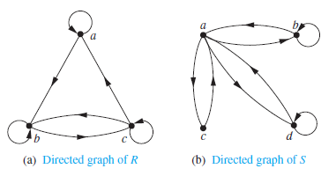
Determining properties of relation using directed graph
A relation is reflexive if and only if there is a loop at every vertex of the directed graph, so that every ordered pair of the form (x, x) occurs in the relation.
Because there are loops at every vertex of the directed graph of R, it is reflexive.
Because loops are not present at all the vertices of the directed graph of S, this relation is not reflexive.

Slide 37
Continue
A relation is symmetric if and only if for every edge between distinct vertices in its digraph there is an edge in the opposite direction, so that (y, x) is in the relation whenever (x, y) is in the relation.
Similarly, a relation is antisymmetric if and only if there are never two edges
in opposite directions between distinct vertices.
R is neither symmetric nor antisymmetric because there is an edge from a to b but not one from b to a, but there are edges in both directions connecting b and c.

Slide 38
Continue
S is symmetric and not antisymmetric, because every edge between distinct vertices is accompanied by an edge in the opposite direction.

Slide 39
Continue
Finally, a relation is transitive if and only if whenever there is an edge from a vertex x to a vertex y and an edge from a vertex y to a vertex z, there is an edge from x to z (completing a triangle where each side is a directed edge with the correct direction
R is not transitive because there is an edge from a to b and an edge from b to c, but no edge from a to c.

Slide 40
Continue
S is not transitive, because (c, a) and (a, b) belong to S, but (c, b) does not belong to S.

Slide 41
Equivalence Relations
A relation on a set A is called an equivalence relation if it is reflexive, symmetric, and transitive.
Two elements a and b that are related by an equivalence relation are called equivalent. The notation a ∼ b is often used to denote that a and b are equivalent elements with respect to a particular equivalence relation.

Slide 42
Example
Let R be the relation on the set of integers such that aRb if and only if a = b or a = −b. In already showed that R is reflexive, symmetric, and transitive. It follows that R is an equivalence relation.

Slide 43
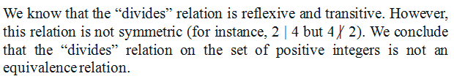
Example
Show that the “divides” relation is the set of positive integers in not an equivalence relation.
Solution

Slide 44
Equivalence Relations
A relation on a set A is called an equivalence relation if it is reflexive, symmetric, and transitive.
Example
Let R be the relation on the set of integers such that aRb if and only if a = b or a = −b. We already showed (Show in detail) that R is reflexive, symmetric, and transitive. It follows that R is an equivalence relation.

Slide 45
Example
Let m be an integer with m > 1. Show that the relation R = {(a, b) | a ≡ b (mod m)} is an equivalence relation on the set of integers.
Solution
a ≡ b (mod m) if and only if m divides a − b.
Note that a − a = 0 is divisible by m, because 0 = 0 ・ m. Hence, a ≡ a (mod m), so congruence modulo m is reflexive.
Now suppose that a ≡ b (mod m). Then a − b is divisible by m, so
a − b = km, where k is an integer. It follows that b − a = (−k)m, so b ≡ a (mod m). Hence, congruence modulo m is symmetric.

Slide 46
Solution-continue
Next, suppose that a ≡ b (mod m) and b ≡ c (mod m).
Then m divides both a − b and b − c. Therefore, there are integers k and l with a − b = km and b − c = lm. Adding these two equations shows that a − c = (a − b) + (b − c) = km + lm = (k + l)m. Thus, a ≡ c (mod m). Therefore, congruence modulo m is transitive.
It follows that congruence modulo m is an equivalence relation.

Slide 47
Example
Show that the “divides” relation is the set of positive integers in not an equivalence relation.
Solution
we know that the “divides” relation is reflexive and transitive. However, we know that this relation is not symmetric (for instance, 2 | 4 but 4 | 2). We conclude that the “divides” relation on the set of positive integers is not an equivalence relation. (Show in detail)

Slide 48
Partial Orderings
A relation R on a set S is called a partial ordering or partial order if it is reflexive, antisymmetric, and transitive. A set S together with a partial ordering R is called a partially ordered set, or poset, and is denoted by (S,R). Members of S are called elements of the poset.
Example
Show that the “greater than or equal” relation (≥) is a partial ordering on the set of integers.
Solution
Because a ≥ a for every integer a, ≥ is reflexive.
If a ≥ b and b ≥ a, then a = b. Hence, ≥ is antisymmetric.
Finally, ≥ is transitive because a ≥ b and b ≥ c imply that a ≥ c.
It follows that ≥ is a partial ordering on the set of integers and (Z, ≥) is a poset.

Slide 49
Example
The divisibility relation | is a partial ordering on the set of positive integers, because it is reflexive, antisymmetric, and transitive. We see that (Z+, |) is a poset. (show in detail)
Recall that (Z+ denotes the set of positive integers.)

